Slide 1
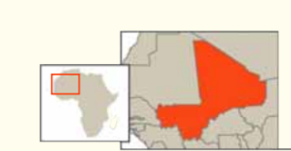
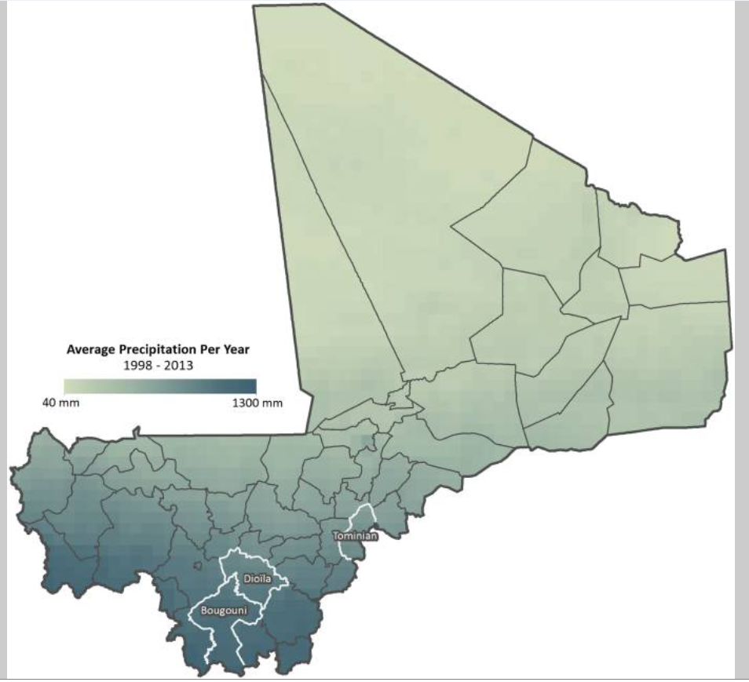
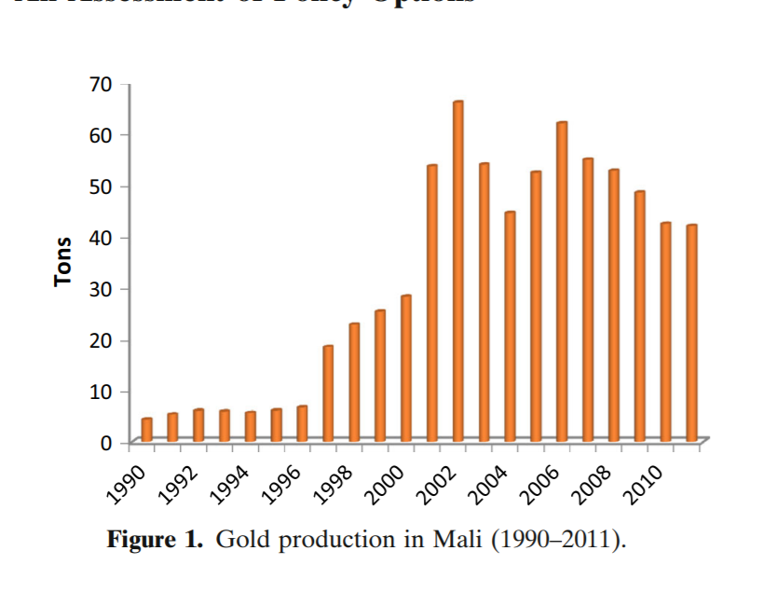
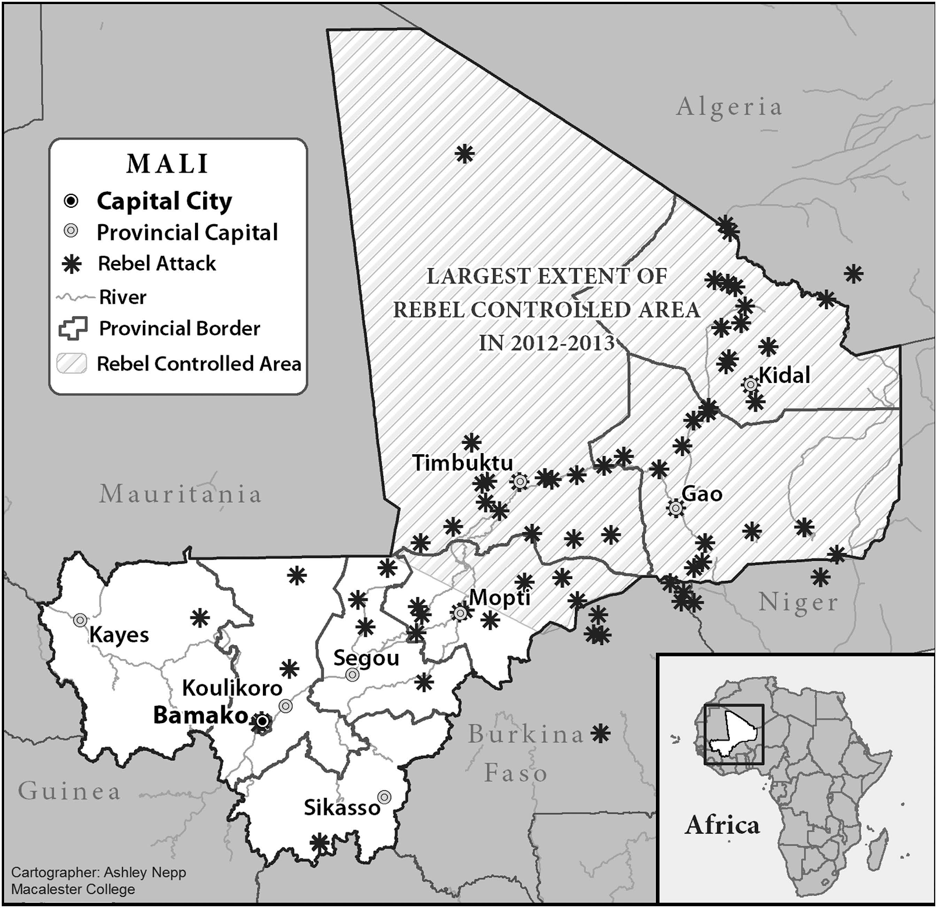
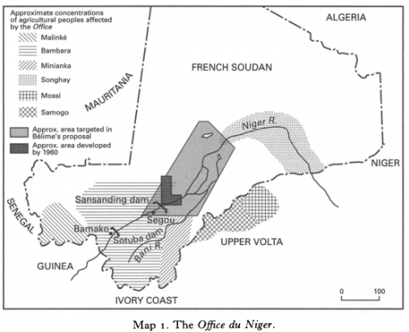
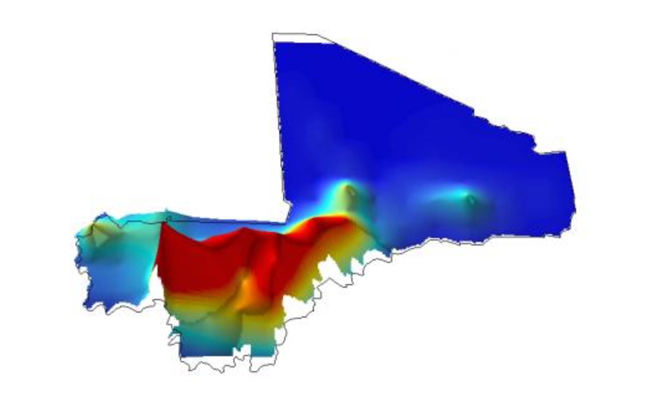
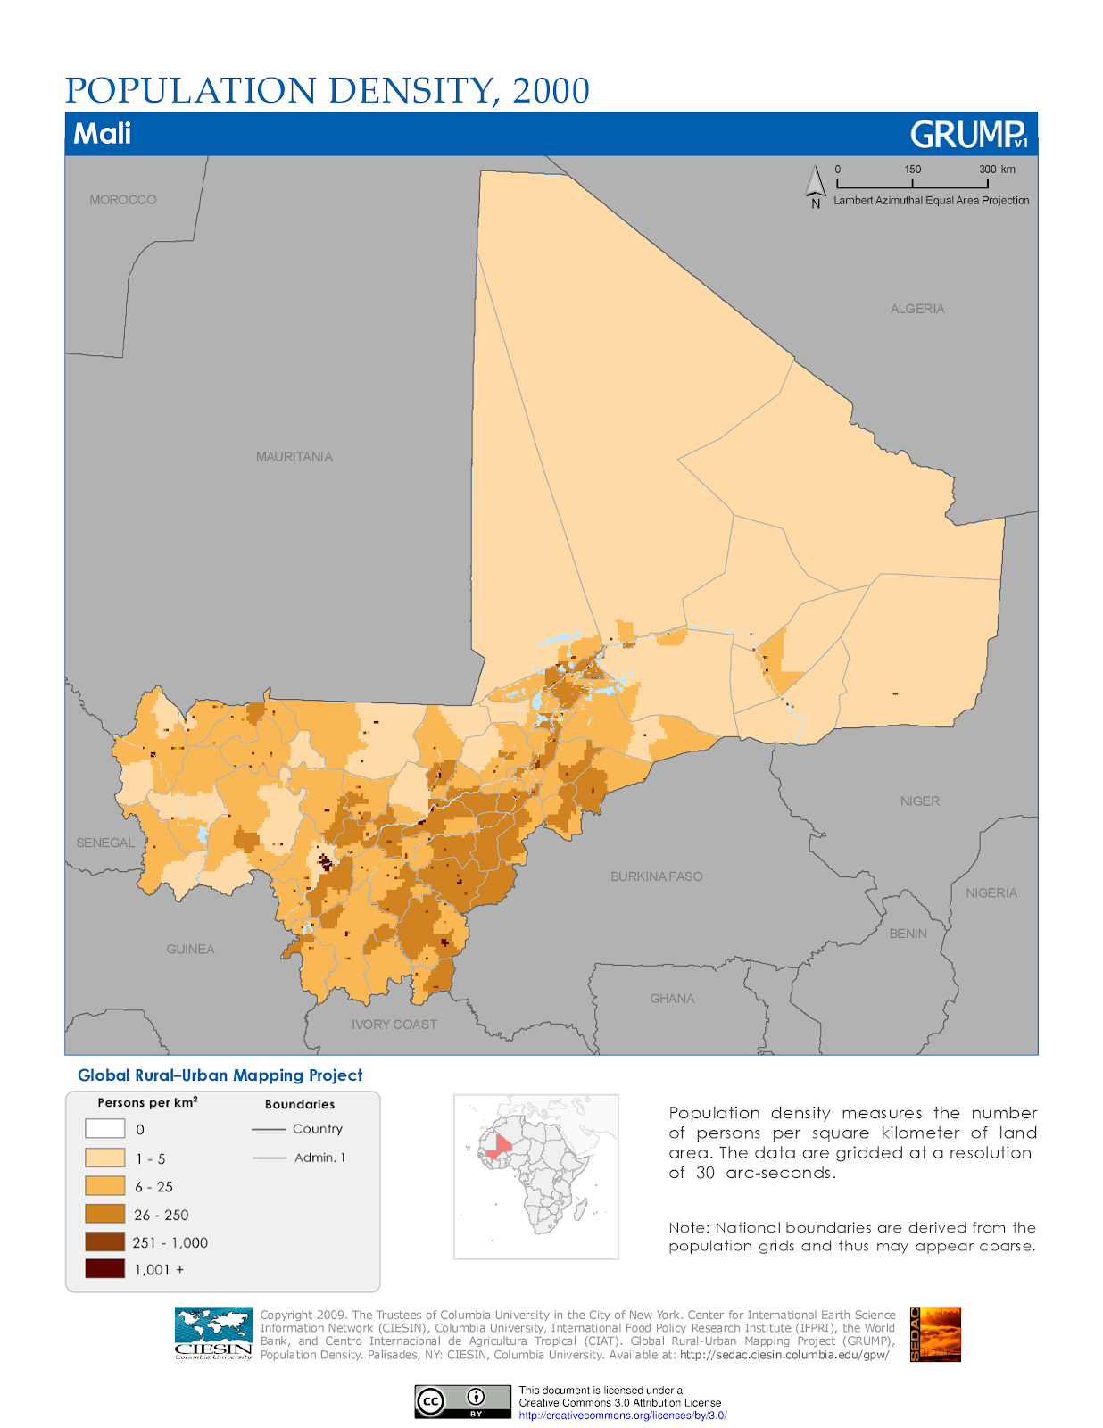
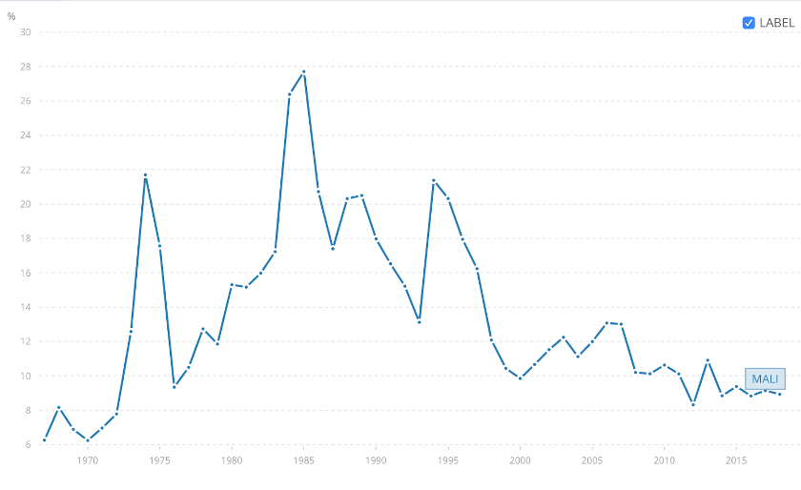
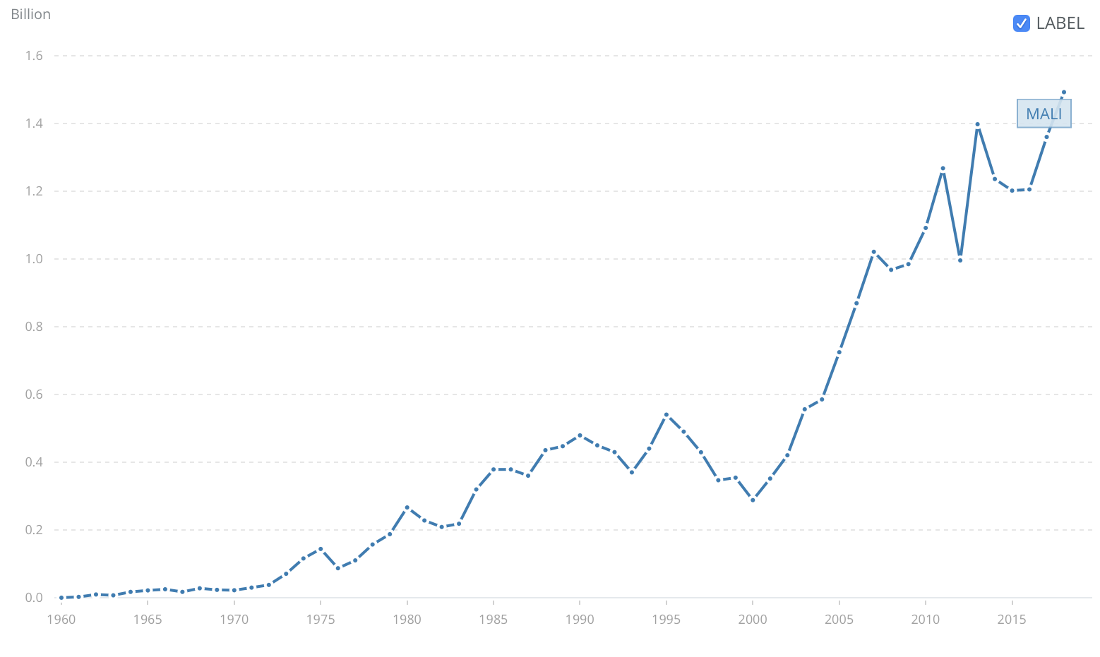
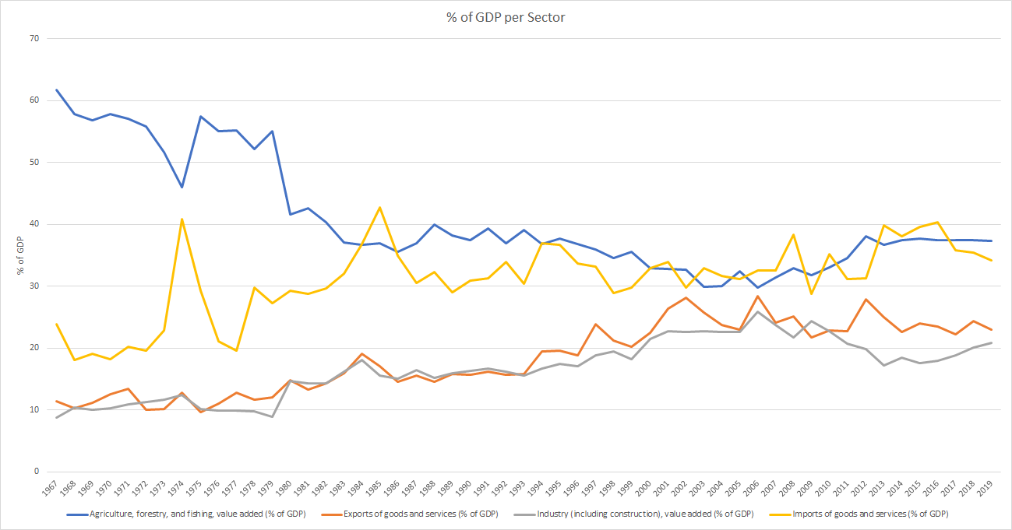
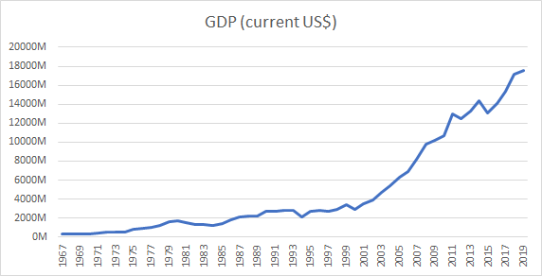
DV 435 Economic and Political Geography in Mali
Eva Hansen, Samantha Njuguna, Caroline Pratt, and Sam Cooling
Location, Endowment and Population
I.1 Location
II.1 Colonial Administration and Infrastructure
Our understanding of the colonial economy of French Sudan cannot be detached from its situation within the federation of French West Africa, with strategic planning at a regional level from the quasi-representative Grand Council. The colonial powers assessed French Sudan as L’Afrique Inutile (useless) due to its land-locked, arid, sparsely populated status, and thus during the move to ‘developmental colonialism’ the F.I.D.E.S developmental funding largely ignored investment in French Sudan, concentrating mainly on railway infrastructure to Senegal and irrigation systems in the Niger Valley. (K.E.R, 1950)
III.1 Economic Activity and the Landlocked Curse
As mentioned in I.4, Mali’s economic activities are largely confined to the riverine area, with agriculture being mostly rain-fed(CIA, 2020). The majority of the population lives in the South, with the most densely populated area around the Burkina Faso border, (CIA, 2020) due to the arid North and political unrest, which has left the northern economy in shambles ("MALI: Northern economy in shambles," 2013). 80% of the population is involved in agricultural activities (CIA, 2020), though agriculture has been decreasing while rural populations have increased, which has led more peasants turning to mining (Brottem & Ba, 2019, p. 5). The desertification, as mentioned in I.2, poses a great risk to these workers’ livelihoods. Mali suffers from being 1 of 17 landlocked countries on the African continent (IOA, 2017). Landlockedness hurts Mali by reducing trade, reduced population mixing, and its geographical remoteness makes utilizing its natural wealth challenging (Carmignani, 2015, p. 4). The political divide, see IV, is associated with the North/South divide caused by economic activity being mostly confined to the Southern regions.
IV.1 Political Unrest: Taking Control of the North
On March 22, 2012, Mali experienced a military coup during which most of the north (Mali’s arid hinterland) was lost to armed rebel groups. Bergamaschi (2014) explains that the north was left vulnerable due to money in the region being ‘poorly used and instrumentalised in local and national politics’. In early 2013, the north was reclaimed due to Operation Serval, undertaken by Malian and French armies (Moseley and Hoffman, 2017). In addition to the French military, the crisis in Mali has involved a number of international actors including ECOWAS and the UN. Despite the involvement of these actors, and the reclaiming of the north, Mali still experiences periodic attacks from extremist groups, with the majority of these attacks taking place in the North- within the area previously held by the rebel groups- as shown in the map above. On the 18th of August this year, Mali experienced yet another coup where President Ibrahim Boubacar Keïta was ousted and Mali's transitional president, Bah Ndaw stepped in. This change has been welcomed by Mali’s citizens who were unsatisfied with Keïta’s administration due to corruption and the further under provision of basic services (BBC, 2020).
Mali is a landlocked country in West Africa, which stretches from the Sahara Desert in the north to the Niger and Senegal River basins in the centre and south (UNEP). Its total surface Area is 1 240 192 km2.
Add text to describe the map inserted on the left
I.2 Agro-ecological Zones
Rainfall levels in Mali are low (280mm/year) (UNEP). However, there is a strong North-South gradient. The North of the country is characterized by extreme aridity with most of the economic activity, food production and human settlement taking place in the South. Indeed, there are four agro-ecological zones in Mali, of which both the Sahelian and the Saharan ones are too dry to cultivate, as rainfall is too low. The only zones that allow cultivation are the Sub Humid zone and the Sudanian Savannah (Waldman and Richardson, 2018). Only 3.8% of Mali’s land is arable! (UNEP).
II.2 Colonial Land Division
The Tuareg and Fulani inhabitants of French Sudan traditionally lived as nomadic herders, therefore land has traditionally been owned in a ‘communal’ sense. French colonial powers imposed a land registration system called Un Regime Foncier – focusing on titling and categorising all land (as natural, artificial, or state-owned). This proved problematic for the nomadic herders, as ‘native occupants’ titling required proof of ‘ownership and cultivation’. Concessions of land were granted for development – largely in the fertile Niger valley.
(Wells, 1999)
The Territory of Mali with Areas under Rebel control in 2012-2013, and Insurgent Attacks in 2014-2016
(Source: Moseley and Hoffman, 2017: pp. 8)
Average Precipitation Per Year
(Waltman & Richardson)
Gold Production in Mali:
Gold production 1990-2010 (Traore & Zebaze, 2015, p. 3)
I.3 Ecological Challenges
98% of Mali’s territory is at risk from desertification. One of the main drivers of desertification is prolonged drought, which is a considerable threat to livelihoods and ecosystems in the country. The concentration of population and agricultural activities around the Niger River (following the massive colonial irrigation of the Niger Valley, see II.2), put this fertile area especially at risk. (UNEP)
Economic Map of Mali:
GDP per square kilometer, data from 2009. (Yale University, 2009)
III.2 The Reliance on the Gold and Cotton Industry in Mali
In Mali, gold and cotton makes up 80% of export earnings (OEC, n.d.) In recent years, Gold mining extraction and the cotton industry, especially in the marginal cotton areas, have been decreasing. In response, Mali has developed its iron ore extraction and maize industries (Coulibaly et al., 2014, p. 1) to diversify its foreign exchange earnings (CIA, 2020) . Mali’s other industrial activities focus on processing farm commodities (CIA, 2020), construction, and phosphate. Since the 1950s, cotton has been the main foreign exchange earner of Mali (Coulibaly et al., 2014, p. 1) when the French colonizers moved away from gold production in favor of cotton (Traore & Zebaze, 2015, p. 2). Following independence, Mali’s’ poor economic performance left it relying on SAPs, liberalizing cereal markets and reduced tariffs on grains. The grain marketing board relinquished its monopoly while the cotton sector remained partially state controlled (Moseley et al., 2010, p. 6). Today, there is a complex political history between the emerging growers’ organizations and the state-owned cotton company which has increased peasant participation in the industry as well as gave rise to a cotton elite (Roy, 2010, p. 4). Until the 1990s, gold mining was limited by a lack of technology (Brottem & Ba, 2019, p. 2) but has seen a huge increase due to investment by foreign companies operating in the four main mines: Sadiola, Yatela, Morila, and Syama (Traore & Zebaze, 2015, p. 3).
IV.2 Global Interference in Mali
Global institutions and donors have played a key role in Mali’s development process, but not always in a constructive manner. Foreign aid, particularly from the European commission, often came with controversial conditions that aligned with their priorities however, did little to address the concerns of Malians (Bergamaschi, 2014). This contributed to the growing dissatisfaction in Mali, and donors failed to recognise the signs that could have prevented the 2012 coup. Moseley and Hoffman (2017) offer an alternative perspective stressing that external actors could be useful to Mali’s development however, it is crucial that those in power have the courage to turn down donors when their input is not constructive. The figure above shows that this is highly plausible as overseas development assistance has steadily decreased as a percentage of gross national income has decreased over time, despite increasing in absolute terms- indicating that global influence is not as strong as it was in the late 20th century.
Colonial Map of French Sudan:
Situating French Sudan within French West Africa (L'oeuvre de la France en Afrique occidentale, numéro spécial de L'Illustration, 29 février 1936, p. 261)
Office Du Niger Map:
Colonial map of planned agricultural irrigation in the Niger delta
I.4 Mineral Endowment
Mali is Africa’s third largest gold producer and the ninth in the world (Traore & Zebaze, 2015). Gold mining represented 14% of the national GDP in 2006 (Bermúdez-Lugo, 2006). Mali’s gold mining takes place both on an industrial level and on an artisanal one and represents a large source of income for many Malian households (as explained in III.2). Most of the production stems from Kenieba Valley, as well as from other regions in the southeast of the country.
II.3 Colonial Export And Agriculture
The flagship Office du Niger was established as one of the only two large-scale colonial irrigation projects, with initial plans to redeem 1,850,000 hectares predominantly growing long-staple cotton (seen as the only viable cash crop), however, 20 years later saw only a maximum of 60,000 hectares improved – and the project never reached suitable scale for profitability. The failure rests on two premises – that the sparse population of the delta (300,000 of which 200,000 were nomadic) and arid ecoregional soils could sustain such a vast agricultural system. Further due to the 700 mile distance to port, efforts towards developing profitable export commodities outside of limited cotton production failed. (Filipovich, 2001)
The F.I.D.E.S emphasis on Senegalese exports pushed Senegalese agricultural production into a peanut growing monoculture – generating domestic food insecurity. This consequently led to the colonial satellisation of French Sudan in which its main economic role became the provision of food (grains and livestock) to supplement Senegalese food supply. The importance of this exemplified by negotiations on the eve of independence aimed at creating a smaller Senegalese-Malian federation (although this ultimately failed). (K.E.R., 1950) (Cooper, 2002
Population Density
(CIESIN, Columbia University)
I.5 Population
Mali is among the fastest growing countries in Africa. Its population was 5 264 000 in 1960 and 19 080 000 in 2018 (World Bank). The fertility rate in 2017 was 6 children per woman. The figure above maps out the considerable disparity of Mali’s geographic population distribution. Mali corresponds to what Herbst (2000) classifies as a “Hinterland Country”, whereby it is exceptionally large but there are no dispersed areas of high population. Indeed, the population is concentrated in one single area of the country - the rest of the territory being a vast hinterland. The livelihoods in this "hinterland" consist mainly of pastoralism and trade.
Net Overseas Development Assistance received as % of GNI in Mali
Data from World Bank
Net Overseas Development Assistance received over time
Data from World Bank
% of GDP by Sector:
Data from 1967-2019
(World Bank, n.d.) Combined by Author
GDP in US Dollars
Data from 1967-2019
(World Bank, n.d.) Created by Author

