Slide 1
PRESENTATION DV435
COMPARISON OF NIGERIA & TANZANIA
JONATHAN TERREFE, DAVID CHUKWUKELU, ELISE EL NOUCHI, TIMEYIN ARAWORE, OORE AKINOSUN & LAURA WEFERS
https://www.youtube.com/watch?v=Qj5x6pbJMyU

Slide 2
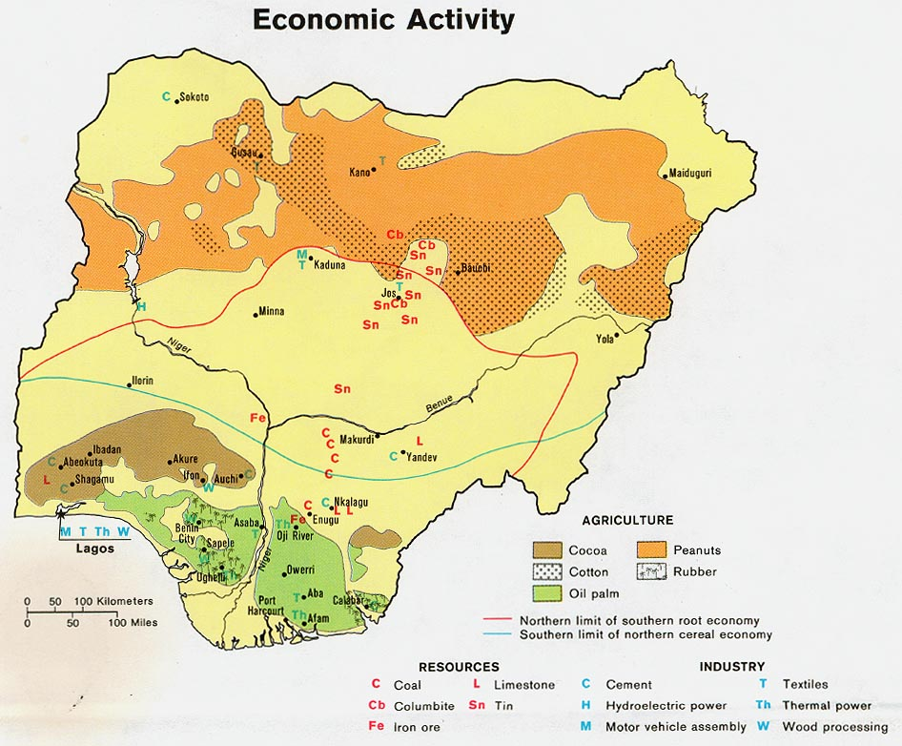
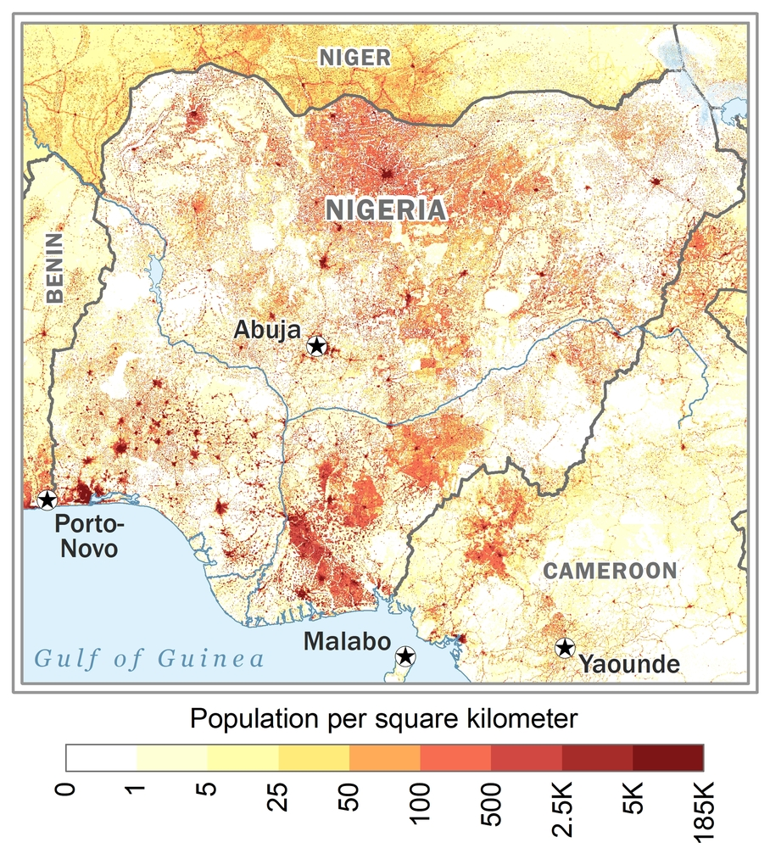
NIGERIA
LOCATION & ENDOWMENT
Location: Western sub-Saharan Africa and is considered a coastal resource rich country with prime agricultural conditions
Resource endowment: a strong agricultural sector incl. cocoa, palm products, groundnuts, cotton and rubber as well as a high abundance in oil, which started to become more prominent during the 1970s
Population: heterogeneous in terms of religion, language as well as unique historical ancestry and customs; as well as a North-South divide with half of the population lived in the poor north; and the more educated and commercially oriented south

Slide 3
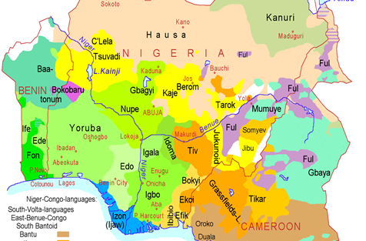
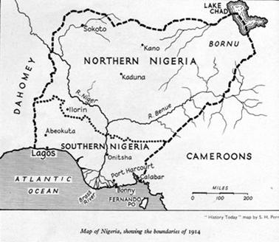
NIGERIA
COLONIAL ECONOMY & INSTITUTIONS
Precolonial ‘Nigeria’
Before the Berlin conference, the largest ethnic groups were the Hausa/Fulanis ruled by emirs of the Sokoto Caliphate, the Yorubas and the Igbos (King, 2016)
Under British rule, the region was governed as 2 separate protectorates until 1914
Indirect rule and North-South cleavages
Northern Nigeria was ruled indirectly, but the South was ruled directly by the British
All emirs, district and village heads had to be approved, and could be removed by the British
The British wanted to keep Christian missionaries and those that were missionary-educated out of the Muslim-ruled North
"Christian-tainted" European education was restricted in the North creating educational disparities between the North and South

Slide 4
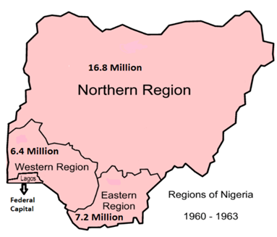
NIGERIA
COLONIAL ECONOMY & INSTITUTIONS
Cocoa and the colonial economy
The North produced cotton and groundnuts and cocoa was produced in the Southwest
From the 1950s to mid-1960s, Nigeria was one of the world’s leading cocoa exporters and agriculture made up 60% of GDP.
The cocoa sector declined with the onset of the Biafran war and the discovery of oil in the 1960s
Pre-independence Politics
In 1939, the South was divided into the East and West, but the North was left intact
The North received the greatest share of national revenue and elected the most representatives to the federal parliament (Hill, 2012).
Three main political parties emerged in the late 1950s – the NPC, NCNC and AG
Each party relied heavily on support from voters within its own region, and none claimed to represent the interests of all Nigerians (Hill, 2012).
In the 1959 election, each party won seats within their core region, but had no appeal outside these areas, reinforcing the ethnic and regional divisions in Nigeria.

Slide 5
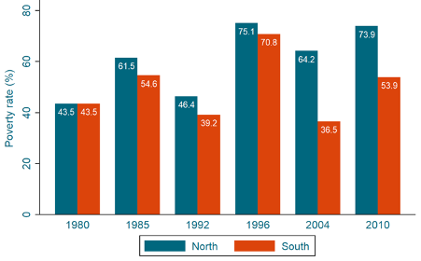
NIGERIA
ECONOMIC GEOGRAPHY
Economic geography snapshot –spatial inequalities:
Urban centers along the coast in Southern region and in the North around Kano
Rural areas in central plateau suffer from poor market access and low agricultural productivity
the result of centralized politics and environmental changes (Nugent 2012)
Strong urbanization and population growth : unemployment rates deepening: 23% in 2018 (World Bank 2018)
Economic geography evolved throughout time:
Colonial economic patterns of production and patronage practices: taxation, transaction rights (Berry 1993)
60s-70s: Pre-established patronage system inherited from colonial times stronger at independence
Focus on centralized economic growth around cocoa and agricultural products exports, crops areas
Turning point 1970s with oil exploitation and exports
Strengthening the relationship between global firms and state rulers:
Pyramidal patronage (Cooper 2002)
Sectorial trade-off: agricultural production decreases and industry limited in spigot economy
Blocking diversification of the economy
South favoured at the expense of the North
Positive: building boom, protection in front of SAP, oil crisis benefits
80s onwards: external vulnerability unbalancing the economy
Fail in oil prices 80s, constraining gov ability to develop the economy, inequalities and redistributive issues
Economic map of Nigeria, GDP per square km. Data from 1990 and 1995.​
Maps credit: G-Econ, Yale 1995.
Poverty rates in Nigeria per region, 1980-2010.​
Source: Households surveys of Nigeria (NBS), Center for Global Development, study by.Zuhumnan Dapel

Slide 6
Nigeria
POLITICAL GEOGRAPHY
Politcal Party Formation
Ethnic divisions of colonial Nigeria and Party formation in the 1950s and 1960s
- Link to the Colonoial Economy
South-eastern Region : 'Igbo's' National Council of Nigeria and the Cameroons (NCNC)
South- western Region: 'Yoruba's' Action Group (AG)
Northern Region: Hausa-Fulani Northern people's Congress (NPC)
Each region was largely self-governing: own constitution, government, legislature, civil service and judiciary.
Relations between them & public policy deemed of national importance (e.g defence) where dealt with by the federal government and the Nigerian parliament

Slide 7
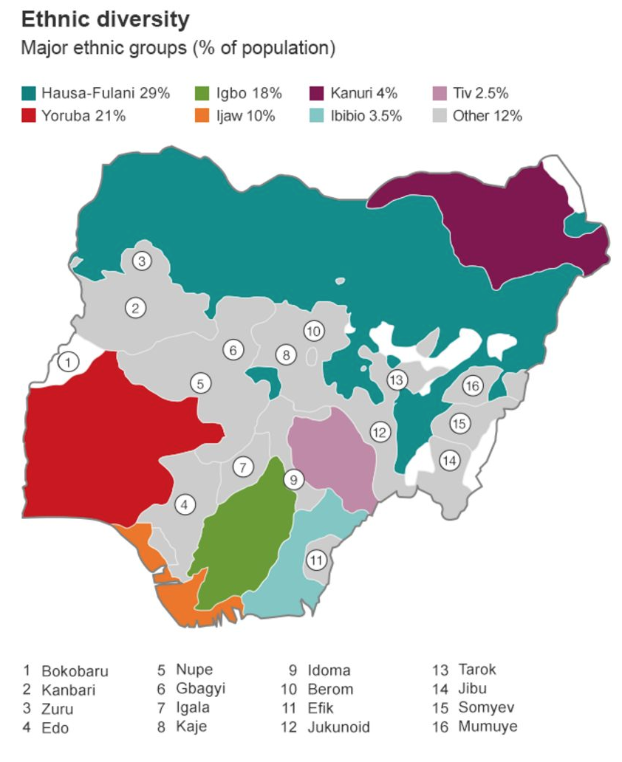
Nigeria
POLITICAL GEOGRAPHY
Political Party Formation
Problems arising from Regional Division
A) Ignored the smaller ethnic groups whose combined members numbered many millions
B) Unequal distribution of the country’s population between the three regions:
Over half of Nigerian population lived in the North
--> North received the greatest share of the national revenue and elected more representatives
to the federal parliament than both the west and east
C) Each party relied heavily on the support it received from the voters of one particular region for its
electoral success and broader political influence
--> None had truly national appeal.
--> (Amplified by 1960 consitution)
--> (Conflict over consenus acccounts)
--> First Coup d'etat in 1966 by Igbo officials after 1964 win of the NNA (Nigerian National Allaince (Coaliation of NPC and southen parties)
--> Lead to its civil War

Slide 8
Nigeria
POLITICAL GEOGRAPHY
PolitcalParty Formation
Underlying Economic Reasons for poltical conflicts
- Link to Economic Geography
Oil Discovery effects on poltical geography
Concern for local demands at federal level became undermined as the potential profits were viewed as the securing financial viability for a future independent Nigeria
--> Oil subordinated local interests when they clashed with national interests (Southern Parties tried to raise notion of appeal which included policy reform which would retain profits and decsion making power in the region of oil exploration)
The rapid growth in importance of this industry has been accompanied by a decline in official interest in the rest of the economy.
--> Oil profits where then used for politcal patronage turning Nigeria into a Spigot Economy
Capital was not used to reinvest into other industries or industrilsation efforts (e.g oil manufracturing)
-> has resulted in rising levels of unemployment and falling standards of living throughout much of the country
--> Oil was further needed to undermine Nigerias position as sub-regional and contiental superpower (post 1970
--> Diversifcation of foreign policy
--> From Pro Westernoutlook:
-Capture of political power by a conservative and aristocratic power elite which interpreted international politics in moralistic
-The colonial state, relations of production and accumulation, patterns of decision-making, institutions and values, were either fully preserved or slightly modified in the process of Nigerianisation
-The domination of the economy by colonial capital later joined by other Euro- American interests remain
--> Oil and the revenues it brought to the government. This enabled the military rulers to rely more on their own resources, buy from whichever market they wished and upgrade themselves to the status of a sub-regional and continental supe

Slide 9
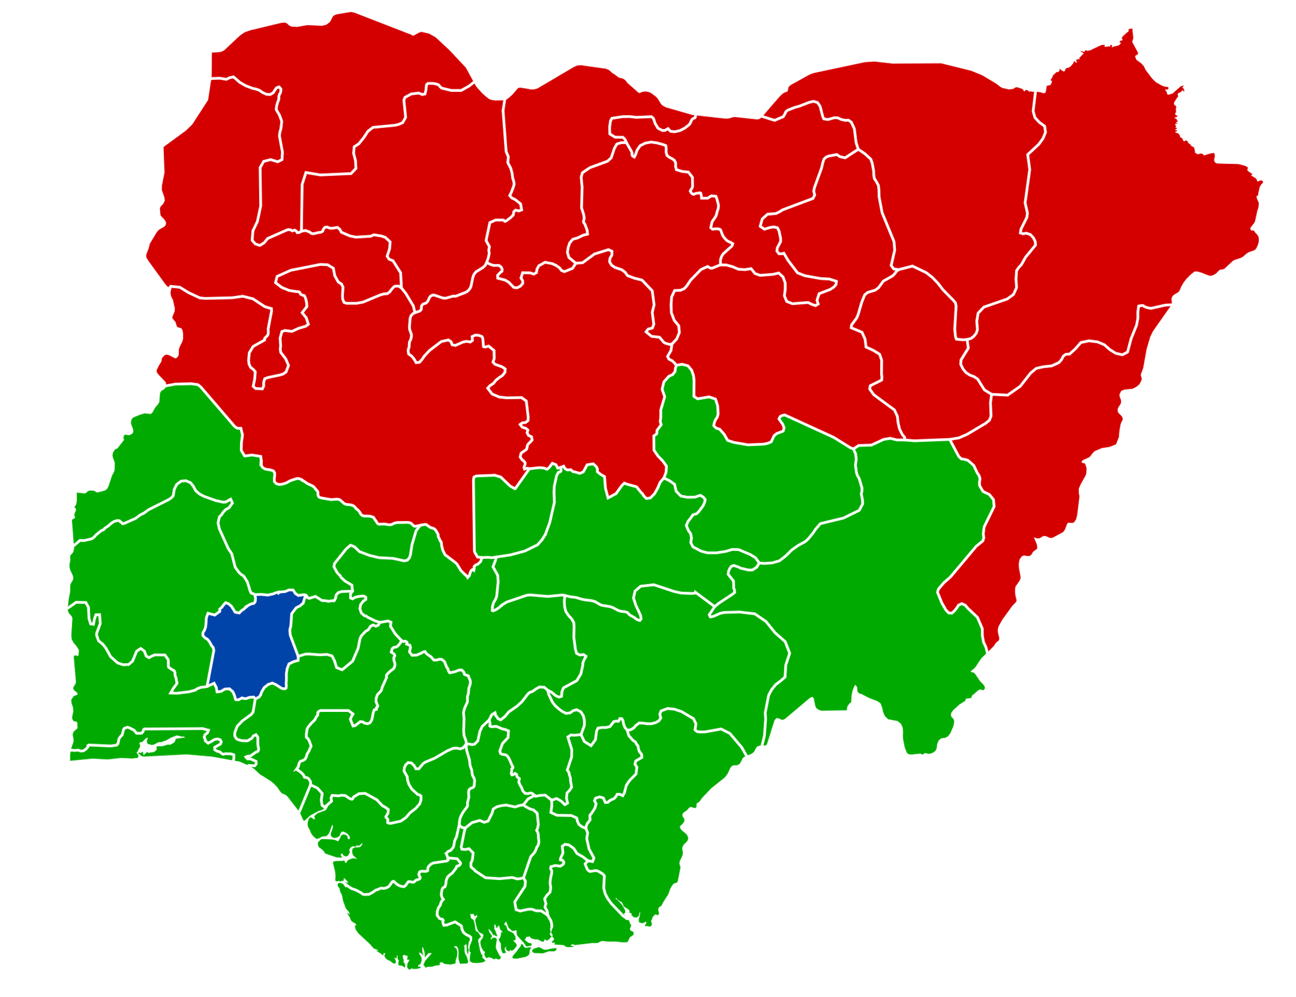
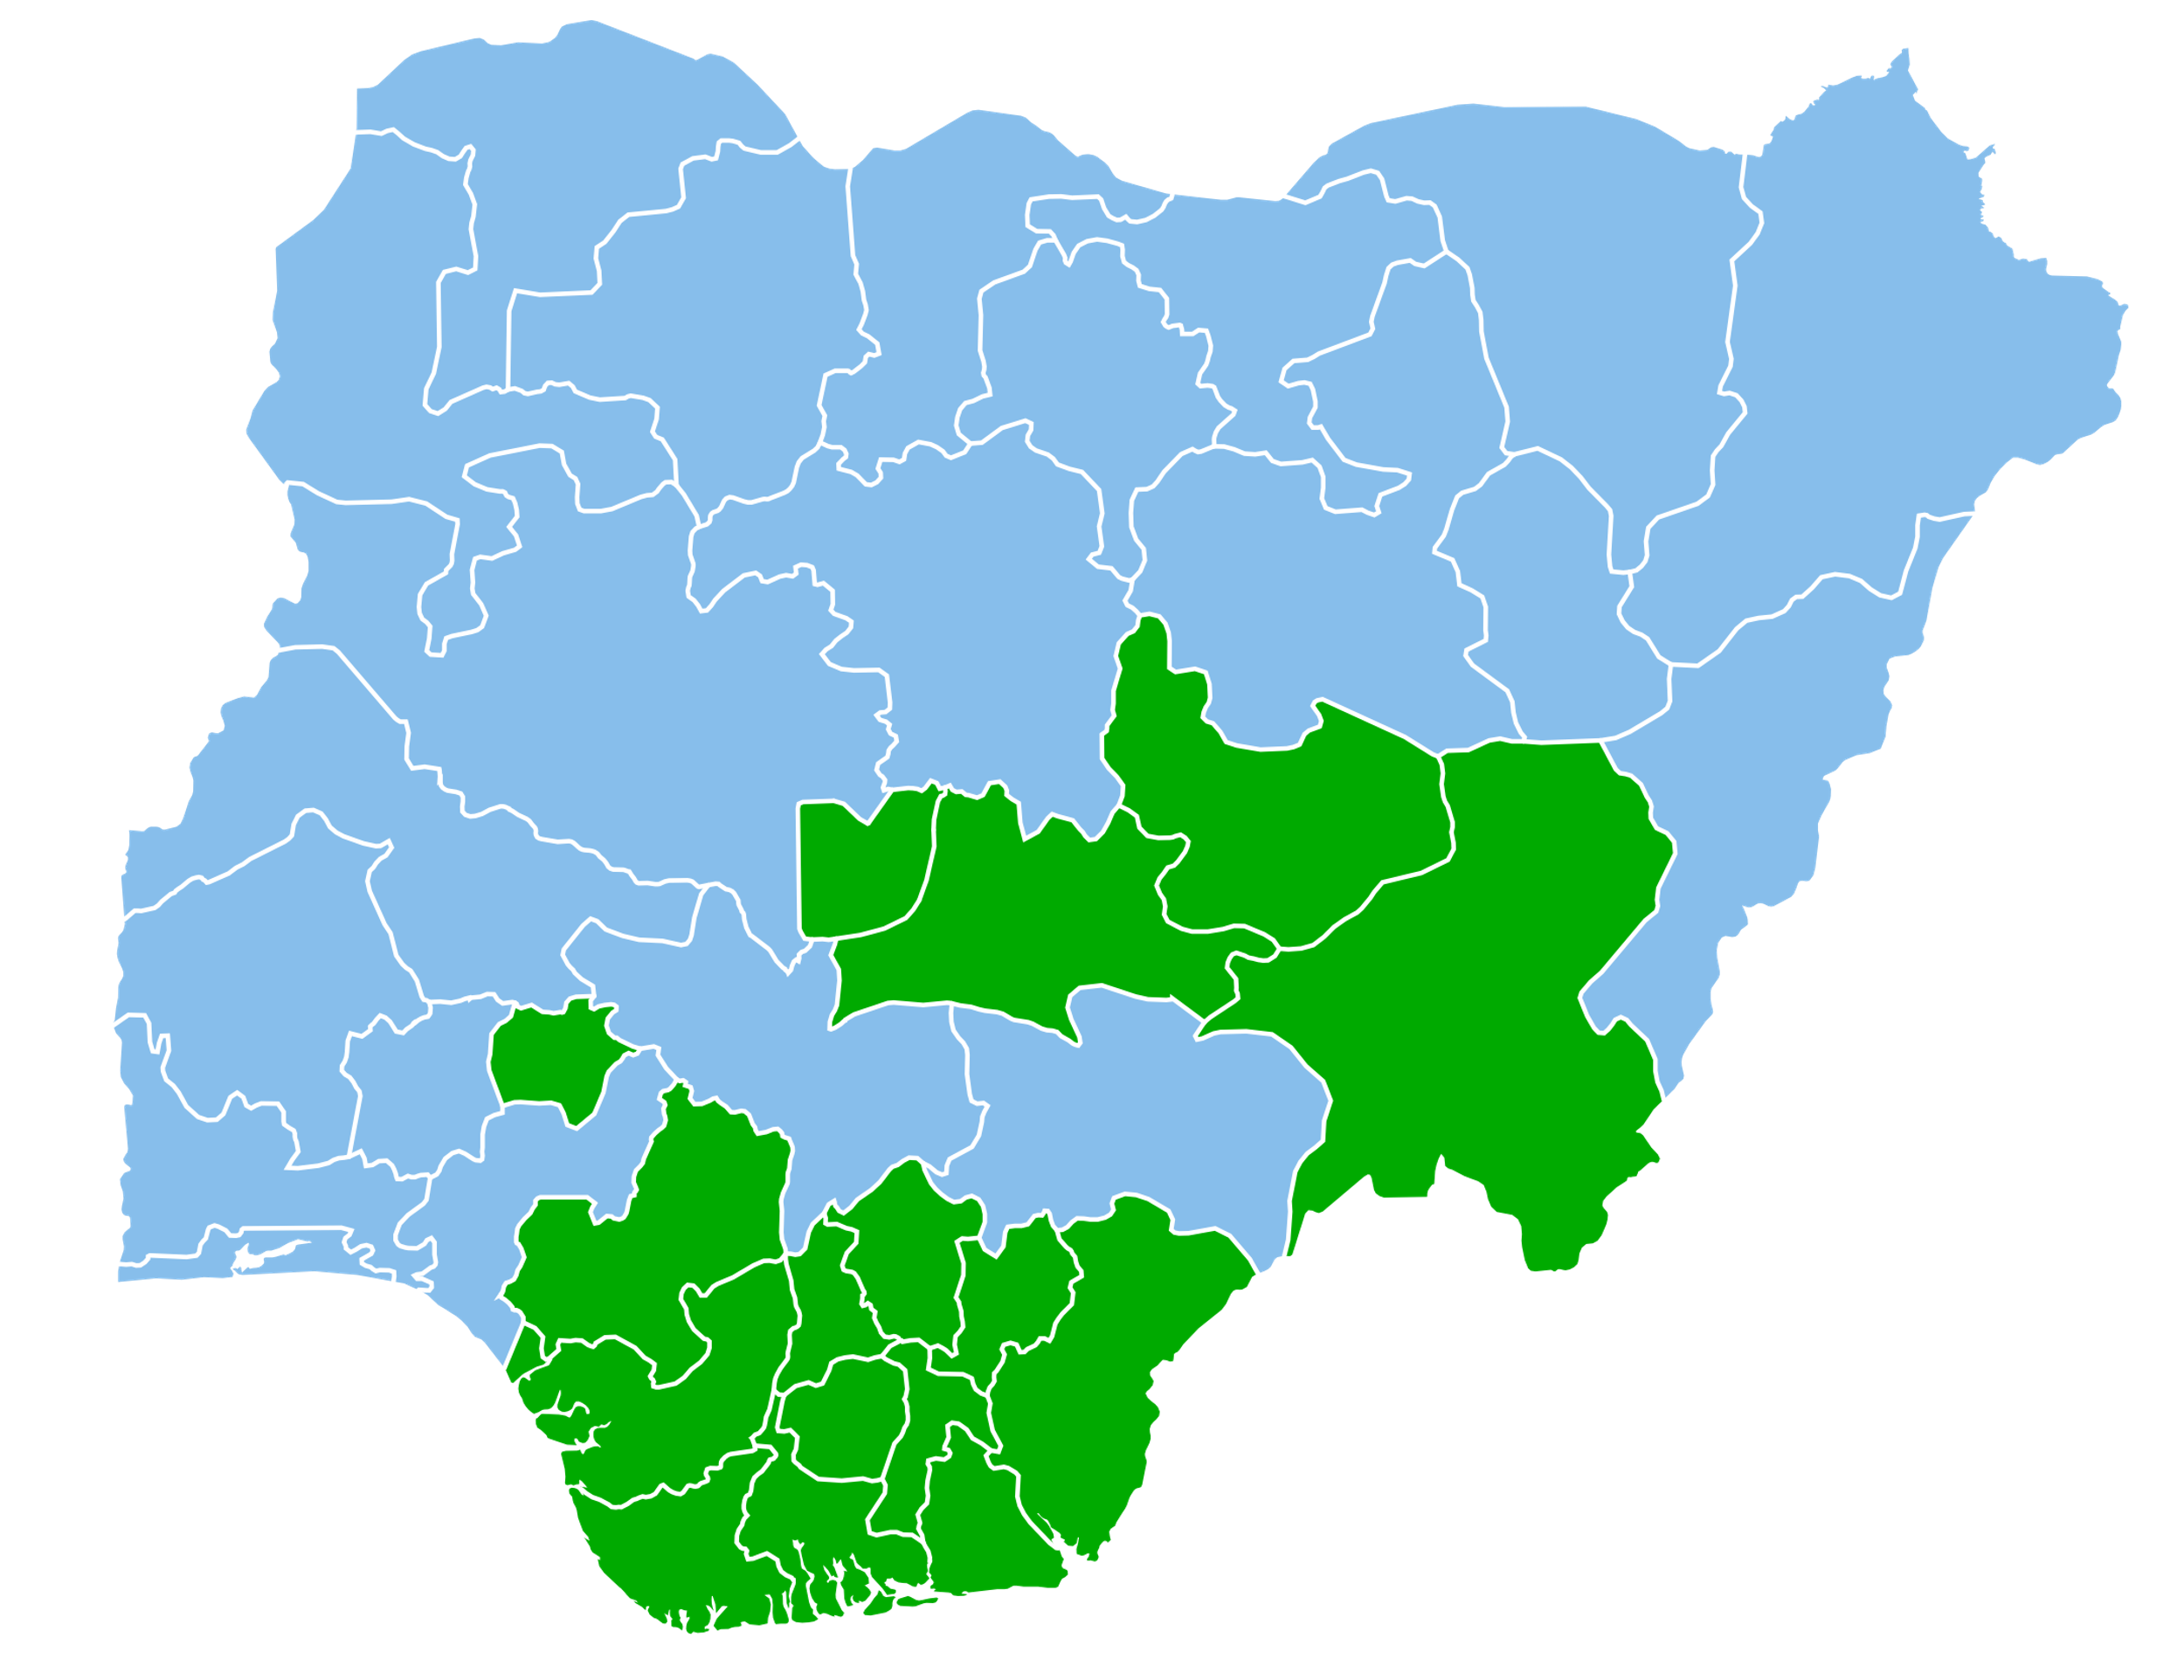
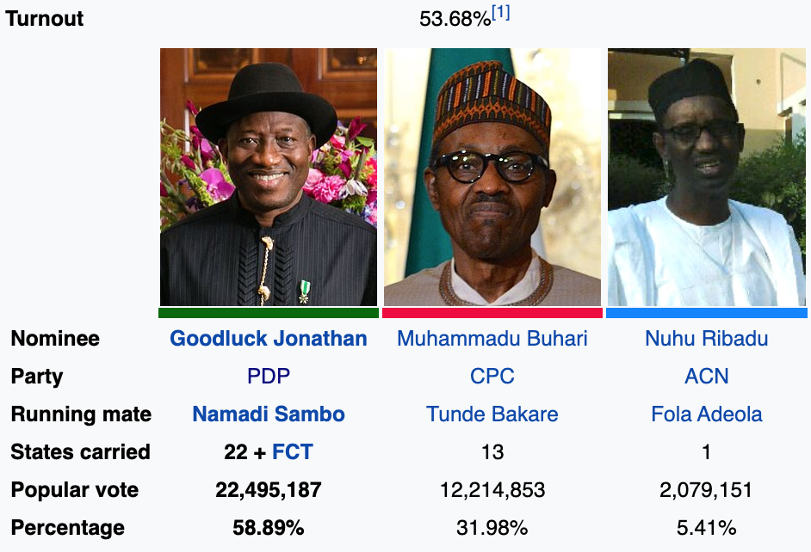
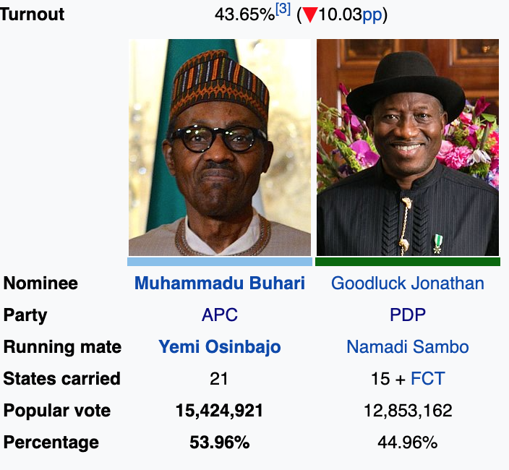
2011 Elections
2015 Elections

Slide 10
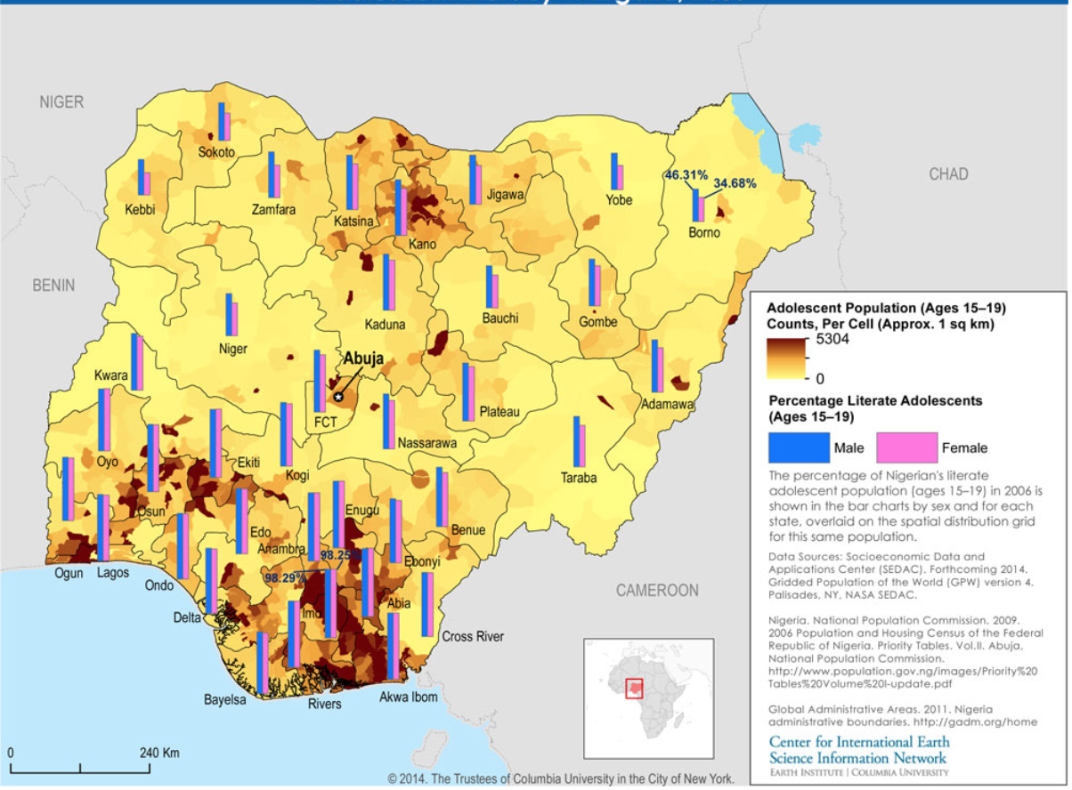
Nigeria
POLITICAL GEOGRAPHY
Electoral Patters Elections 2015
From terrorism to talakawa: explaining party turnover in Nigeria's 2015 elections
A. Carl LeVan, Matthew T. Page & Yoonbin Han 2015
What explains the shift in the 2015 election results?
- partilcuary the PDP support in the sout- west of the country?
Prevailing explanations:
- ‘in advanced economies, cleavages are largely along social class lines...but in Nigeria cleavages are often along primordial lines, such as ethnicity, gender, and religion’ (Okafor 2013, 2)
- 'declining oil prices', 'Rise in Bokoharam terroirsm', 'Corruption'
Talakawa effect:
'Economic Voting': Weak economic conditions in the states systematcially correlate with stronger support with the opposition (APC)
'Common people' excluded from the clientlists system and excluded from the 2000-2014 newly generated wealth
Varibles to test the hypothesis
- states’ internally generated revenue as an instrument for sub- national economic performance
- perceptions of the national economy disaggregated at the state level
- literacy as a proxy for income in local government areas
--> indicators of positive economic performance – whether subjective or objective – are highly correlated with support for President Jonathan, offering robust support for the economic performance hypothesis

Slide 11
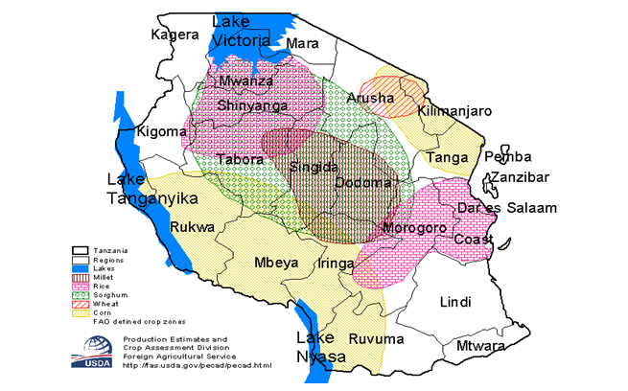
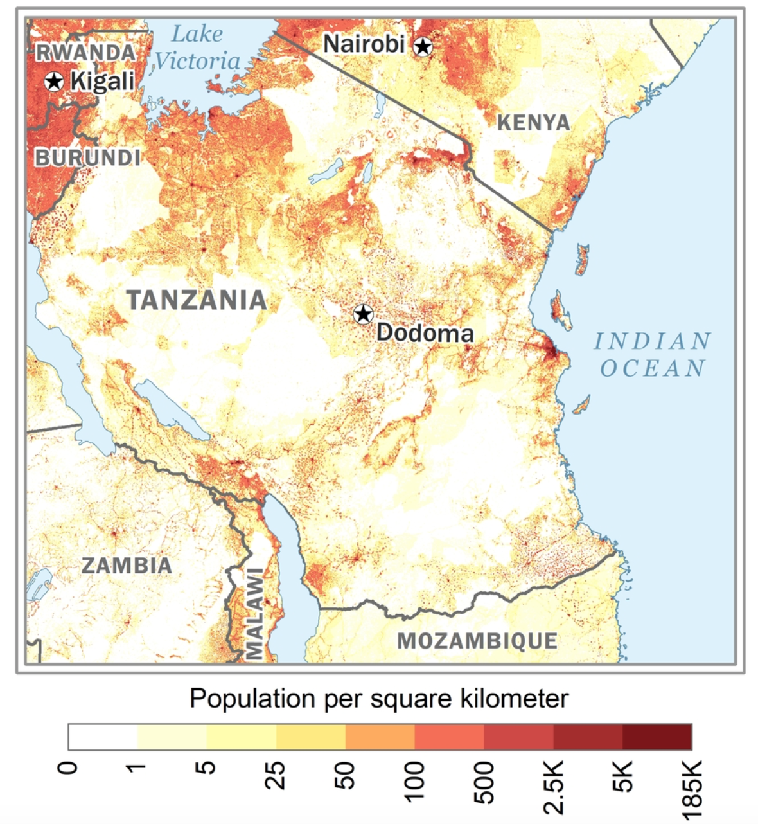
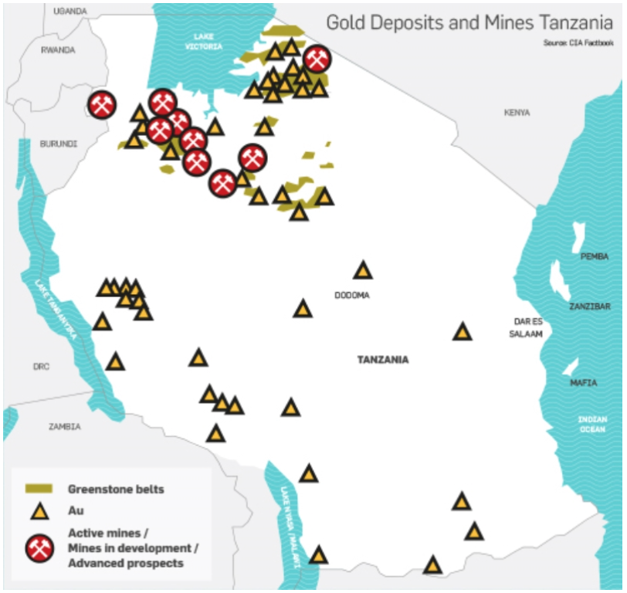
TANZANIA
LOCATION & ENDOWMENT
Location: Eastern sub-Saharan Africa and is considered a coastal resource rich country with prime agricultural conditions
Resource endowment: strong agricultural sector which Tanzania depended on highly in post-colonial times & scattered mining sector that spreads over 800,000 km² with gold playing a major role
Population: highly fragmented population, causing trouble for Nyerere to extend his physical authority over its people which gave rise to the Arusha Declaration in 1967 and the socialist and self-reliance movement

Slide 12
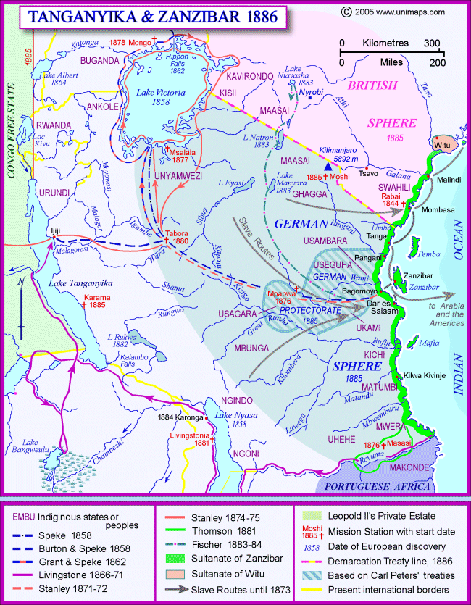
COLONIAL ECONOMY & INSTITUTIONS
TANZANIA
Colonial Land Division
Imperial protectorate of Germany in 1889 (direct/indirect rule), transferred to the British under a League of Nations mandate (indirect rule).
Land alienated to European settlers for cash crop production, especially around Tanga and Mt. Kilimanjaro. British maintained this system also supporting Indian trade over Arab and Swahili companies.
Economic growth promoted through agriculture, mining, and infrastructure. Uneven development within the territory.
State control of commercial agriculture (coffee, rubber, sisal) and marketing. African peasant production encouraged but strictly regulated.
Map of Tanganyika and Zanzibar 1886. Source: Unimaps.com

Slide 13
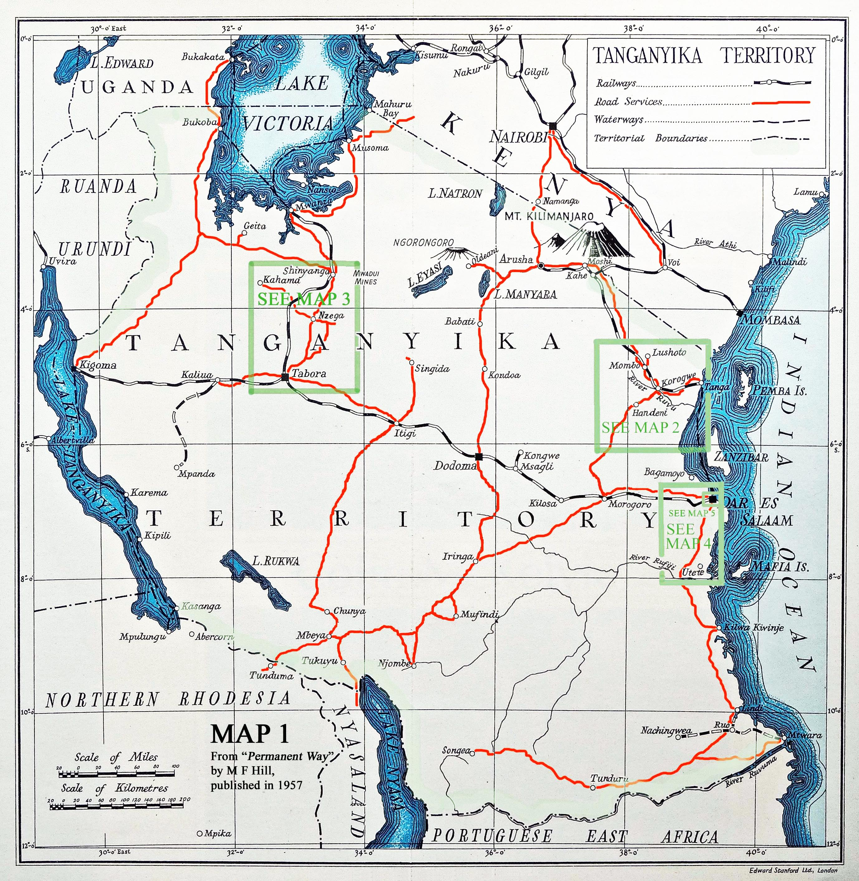
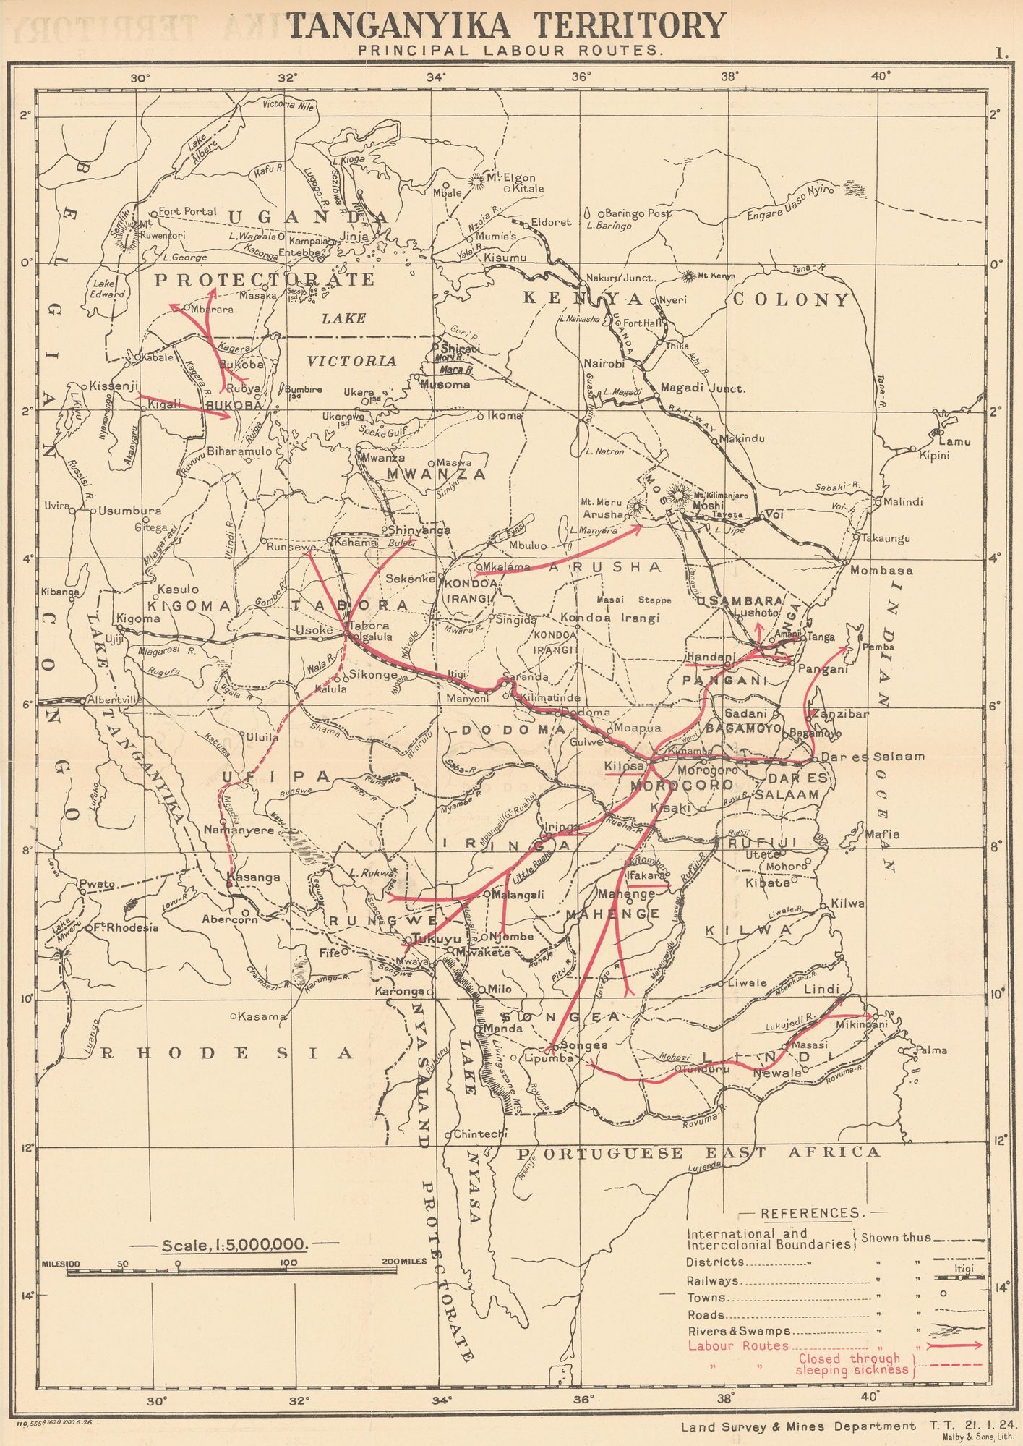
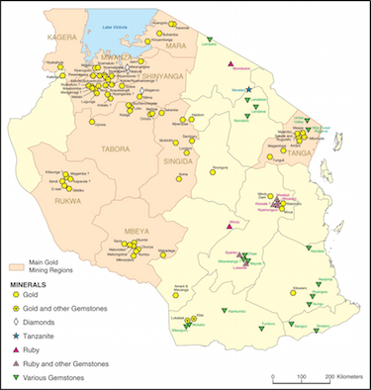
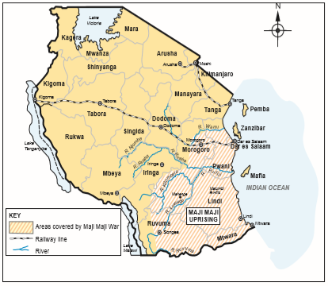
COLONIAL ECONOMY & INSTITUTIONS
TANZANIA
Mining and Infrastructure
German: Minimal mining activity; mine operations caused growth in rural areas; disrupted by WWI.
British: More successful endeavour; 1930s were the golden years; high production and prices; poor labour practices; disrupted by WWII; reduced export share.
German: Built railways and ports to improve commerce and trade. Railway routes marginalised Southern region.
British: Marginal investment in railway extension. Left South underdeveloped to force migration to North and Lake Provinces.
Labour Migration and Labour Protests
Classified as “Africa of the labour reserves” (Amin, 1972).
German forced labour practices led to Maji Maji rebellion. Pivot to pro-peasant policies.
British policy of colony self-sufficiency and poll taxing further maintained labour status quo.
Urbanisation and labour migration patterns were influenced by (intentional) uneven development and economic policy direction.
Some attention was paid to social welfare during colonial times. Political institutions were new and rather unsophisticated by independence.
Small scale mining sites in Tanzania.. Source: Bryceson et al.
A sketch map showing areas affected by the Maji Maji rebellion. Source: Rwanda Education Board
Map of Tanganyika Territory in 1957. Source: Permanent Way by M.F Hill
Principal labour routes in Tanganyika 1928. Source: Land Survey & Mines Dept.

Slide 14
TANZANIA
ECONOMIC GEOGRAPHY
Economic geography snapshot- spatial inequalities:
Two regions concentrating mining, manufacturing and services activities: Dar es Salaam and Mwanza (26.7% of total GDP at current prices – Tanzania National Bureau of Statistics 2018)
1/3 population living in urban areas, high population growth (expected to reach 100 million by 2040 = income and assets disparities along spatial lines (World Bank Report 2018)
Economic geography evolved throughout time:
Rupture from eco structure of colonial times at independence (Cooper 2002)
Few zones of export potential: sisal growing inland from the coast and coffee growing in the North. Around culturally diverse pop living in resource-poor environments. Uneven: South Tanzania neglected (Iliffe 1979).
Attempt to western-like liberalization policies from 60s
TANU linked to rural movements aggrieved by British development and programs
Lack of attractiveness blocking Nyerere's attempt to increase investment and dev
1970s: new economic orientations : socialism & “self reliance”
Arusha Declaration 1967: Nationalization of banking and commerce, ujamaa villages (1972 → 1976: 15 to 91% rural population).
Exports benefitted from increasing prices of coffee.
Failure: resilient mode of production of peasants, low production leads to low pattern of development
fall in living standards more than 40% between 1975 and 1983
Lack of output = External dependency foreign aid.
Economic reboot and reshaping of economy
Multipartyism since 1992: better eco climate coffee exports rising, wider availability of goods, negative impact of SAP
Gold production up by 700% from the 1990s to 2010: Increase in metal prices, sectoral trade-off, inflow of money
Economic map of Tanzania, GDP per square km. Data from 1990 and 1995.​
Maps credit: G-Econ, Yale 1995.
Percentage Share of Gross Domestic Product by Region in Tanzania Mainland 2018.​
Source: Tanzania National Bureau of Statistics. Report. 2019.

Slide 15
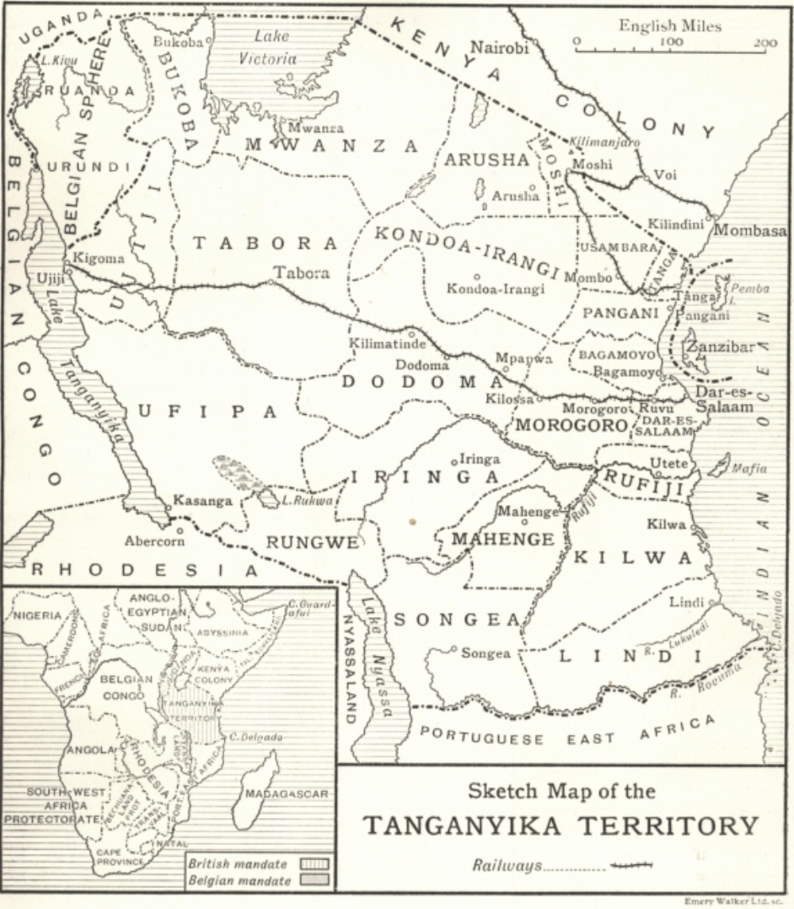
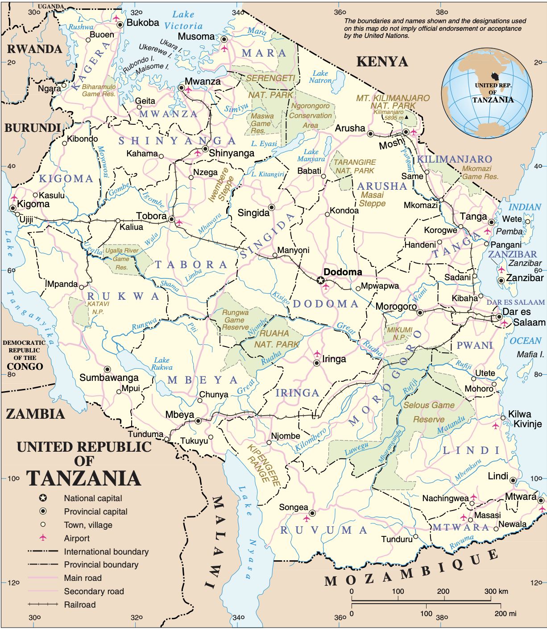
TANZANIA
POLITICAL GEOGRAPHY
Administrative Boundaries and Ethnolinguistic Background
Tanzania Regions (Eriksen, 2018)
After German colonial rule (1884-1919) came to an end, British and Belgian colonial forces took over Tanganyika
The administrative map by 1922 under British rule was predecessor to today's borders (Leggett, 1922).
Today, there are 30 regions and 148 different districts (Commonwealth Local Government Forum, 2018).
Swahili is the national language and English as well as Arabic (particularly in Zanzibar) are considered secondary official languages.
Tanganyika Territory (Leggett, 1922)

Slide 16
TANZANIA
POLITICAL GEOGRAPHY
Territorial Cleavages (or lack thereof)
At independence - TANU had a subordinate role (Hartmann, 2016)
In 1962, political officers became regional and area commissioners – TANU party members filled these roles
The absence of organised opposition was responsible for both TANU's strength and its weakness
TANU would win any electoral contest – however, didn't organize population support convincingly
Arusha Declaration in 1967
By March 1973: 1/3 of total number of villages were in two regions. 5 regions which contributed to less than 25% of GDP accounted for 60% of all villages.
6 most affluent regions (50% of GDP) accounted for only 15% of villages.
Despite diverse religious and ethnic groups in Tanzania, have not been central in determining political support and specific party affiliation (Lofchie, 2013)
"Tanzanians recoil at political parties or leaders that seek to politicize these factors for their political advantage"
Alongside efforts to 'liberalize' the economy in late 1980s, Tanzania became a multi-party system in 1992 (University of Central Arkansas, 2020)
Notes:
Influence significantly increased by 1963 –

Slide 17
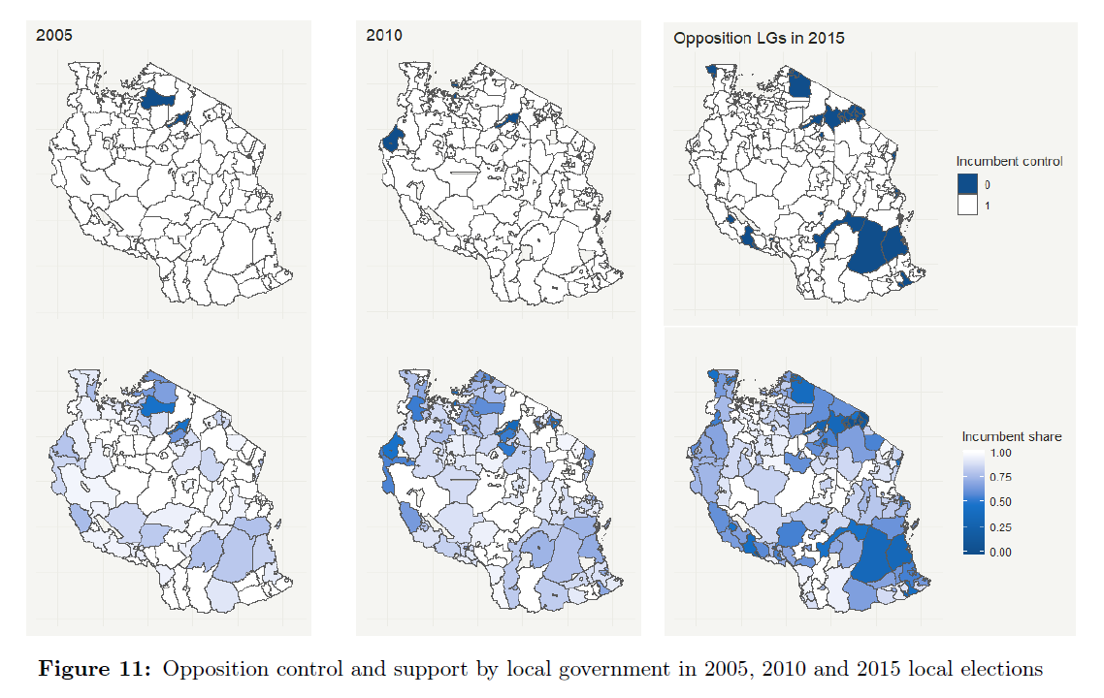
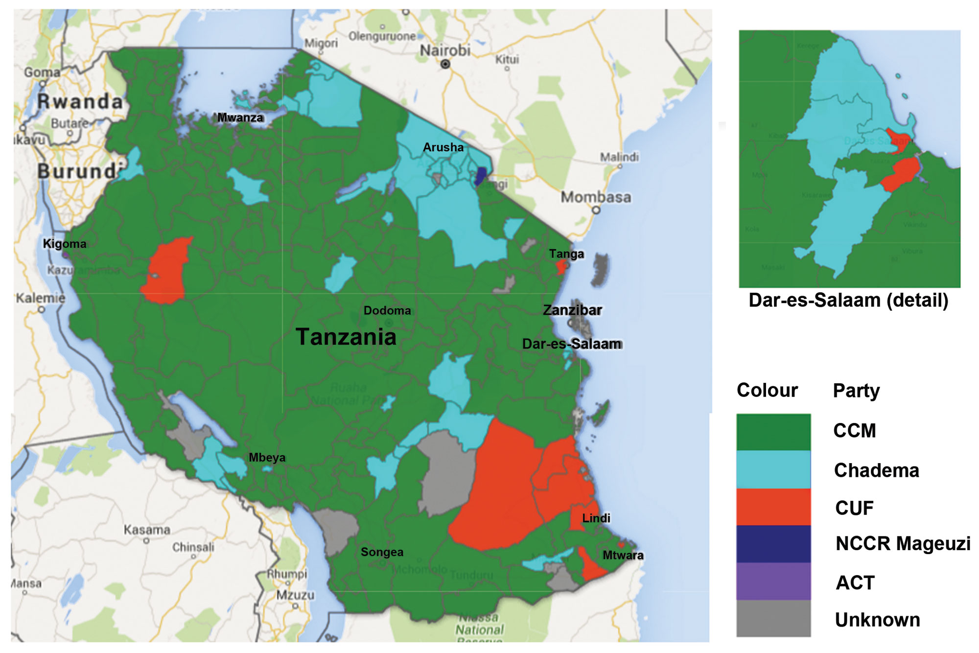
TANZANIA
POLITICAL GEOGRAPHY
Geographical Electoral Patterns
Spheres of government in Tanzania (Anyimadu, 2016):
Central government, Zanzibar House of Representatives, and local government (under district councils)
Electoral map of 2015: Chama Cha Mapinduzi (CCM), the closest opposition parties are the Chadema and the Civic United Front (CUF) (Paget, 2019)
Between 2003-2015, three periods of large-scale campaigns by Chadema have led to an increase in support and helped Chadema with its 'party-building' efforts -
An operation by the youth wing from 2003-2005
'Operation Sangara' in 2007-2010
Series of campaigns in 2012 saw the main opposition widen its support bases, by 2010, "the Chadema presidential candidate vote share rose from 6 to 27%"
In Zanzibar, the CCM have only had a slight lead over the CUF historically (Anyimadu, 2016).
(McLellan, 2020) *unpublished*
("Tanzania Affairs", 2015)
Notes:
Today, it operates under a presidential parliamentary democratic system, with Zanzibar, as a semi-autonomous region (Commonwealth Local Government Forum, 2018). Although both Tanzania and Zanzibar hold executive, judiciary and legislative bodies, in Zanzibar, 'non-union matters' such as health, environment and education are self-governed (Anyimadu, 2016).

Slide 18
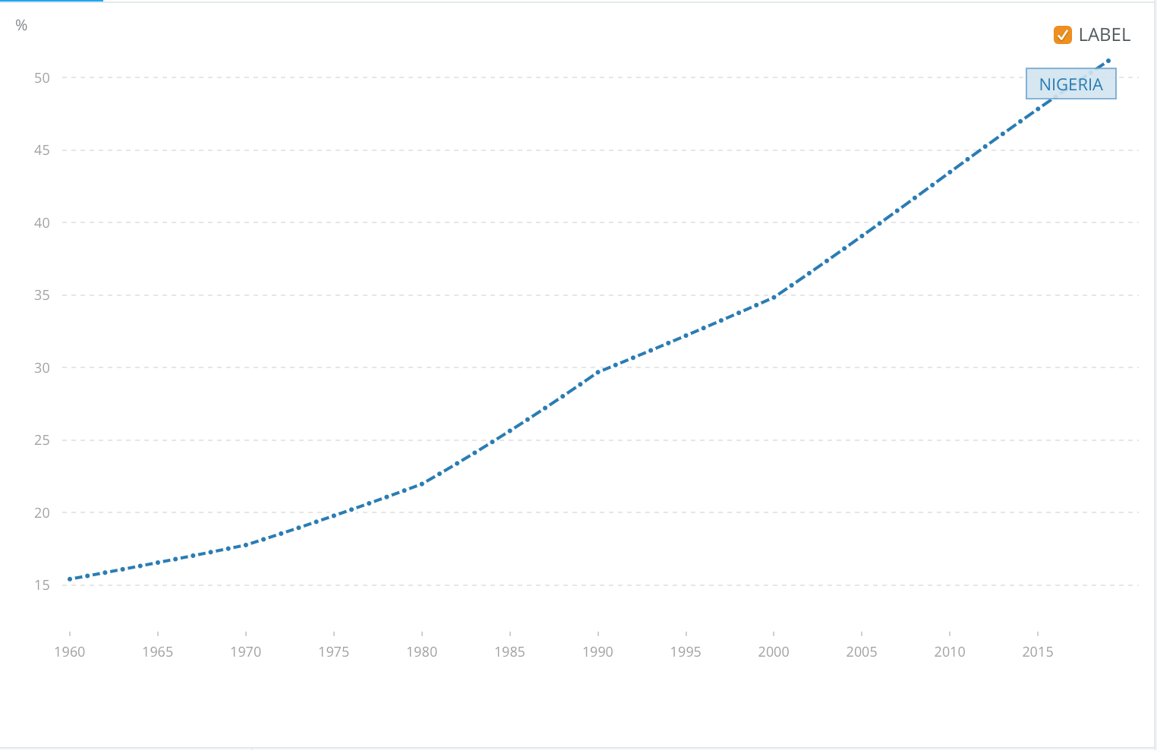
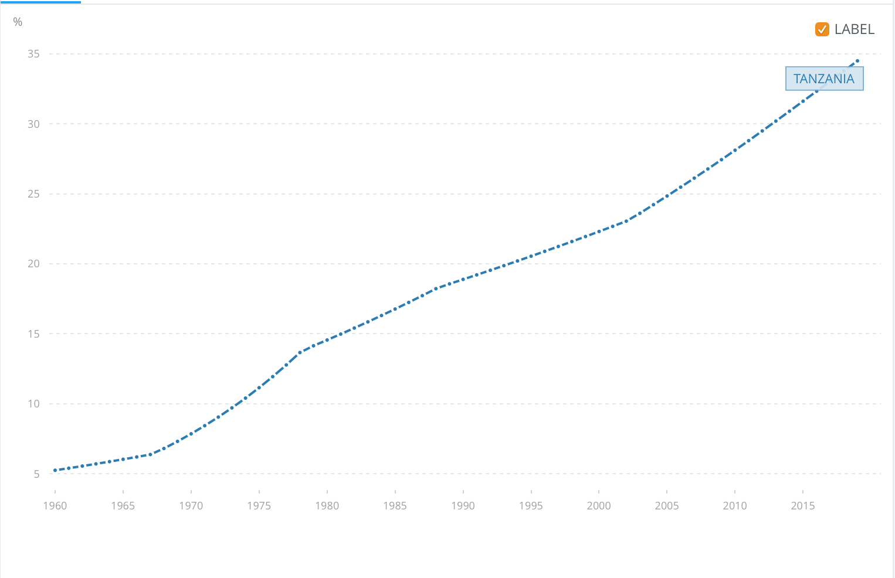
NIGERIA & TANZANIA
COMPARATIVE PATTERNS
Challenges of Urbanization & Population distribution
(Herbst 2000)
Link to colonial structure:
Indirect rule limitations & institutionalization
Rupture VS. Continuity (socialism vs. patronage)
Large territories with poor infrastructure, road building efforts legacy of growth episodes
Nigeria and Tanzania above the African median (69 percent increase) for road density in 1997
Limits: 33 million rural residents unconnected to good roads in 2014 in Tanzania.
Deep challenges to consolidation of power and implication for redistribution of resources and spatial inequalities
Partisan cleavages maps back to urbanization ; eco policies
Urbanization of Nigeria (% of total. population)
Source: The World Bank Group, Data Bank 1960-2020.
Urbanization of Tanzania (% of total. population)
Source: The World Bank Group, Data Bank 1960-2020.
Notes:
Legacies of the growth episodes (Jerven 2010)
Different investment.
Cities
Infrastructures
Generally, era of state developmentalism tries to diversify spatially and sectoral national economies but usually try to do so by enhancing productivity of inherited export sector
Paradox because need pre-existing structure as such.
spatial inequalities overlap with ethnicity → it is because ethnicities institutionalized under colonial rules that persist → thus creating territorial ethnicities linked to a region or place

Slide 19
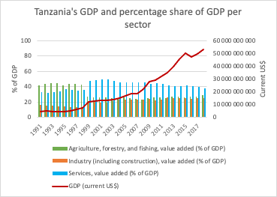
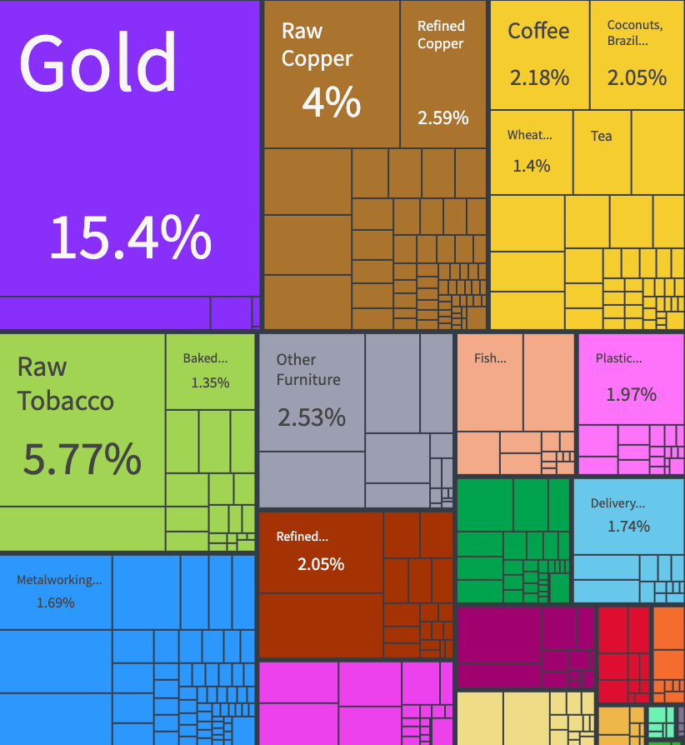
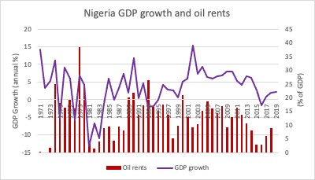
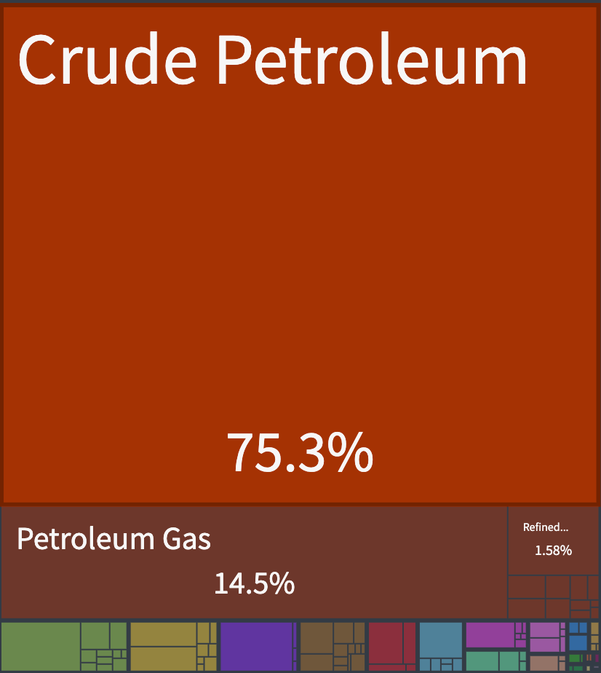
NIGERIA & TANZANIA
COMPARATIVE PATTERNS
Tanzania (TZN) Exports, Imports, and Trade Partners., 2018.
Source: OEC World Country Profile, MIT Observatory
Endowments reshaping both countries' economy
Impact of oil and gold on sectoral productivity:
Tanzania: Shift of labor from agriculture to services = strong growth of 6.8% in 2019 (African Development Bank, 2020).
Nigeria: Services sector accounts for more than 50% of GDP in 2019 (World Bank Data, 2019).
Implications for ownership of resources/power?
Governance issue: resource nationalism in Tanzania
Unemployment: Nigeria oil extraction needs less labor
Vulnerability to external shocks:
Nigeria: 2014 oil price collapse/recession in 2016, contraction of the economy by 1.6% (World Bank overview, 2019).
Tanzania: volatility of oil and gold prices + drop-off of external demand = fall by 4 percent of the value of exports in the year ending in January 2019 (World Bank, 2019).
Source: The World Bank Group, Data Bank 2020.​
Chart combined by the author
Source: Data World Bank 2020.
Chart combined by the author
Nigeria (NGA) Exports, Imports, and Trade Partners., 2018.
Source: OEC World Country Profile, MIT Observatory
Source: The World Bank Group, Data Bank 2020.
Chart combined by the author.
Source: The World Bank Group, Data Bank 2020.
Chart combined by the author.
Source: The World Bank Group, Data Bank 2020.
Chart combined by the author.
Source: The World Bank Group, Data Bank 2020.
Chart combined by the author.
Notes:
In gold and other metals national economy not getting much at all from the resources → need to be exploited for national benefit
Tanzania: new mining country during the commodity boom
1998 mining codes crafted by World Bank as laisser passer for foreign direct investment → liberal and pro foreign investors → contributes little to national or local development
SO Tanzania revised the code in 2010 to get more out of it

Slide 20
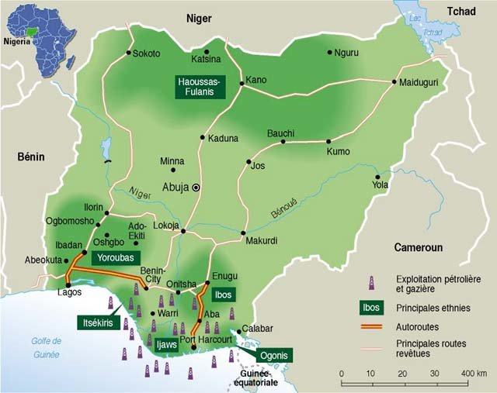
Map of Nigeria with pricipal ethnic groups and oil & gas resources, 2000. Credit: Le Monde, Paris
Source : Neue Chance für Nigerias Demokratie [New prospects for Nigeria's democracy; in German]

Slide 21
DEBATE

Slide 22
Thank you!
https://www.youtube.com/watch?v=UuDVHHeUEi8

